Slide 1
CS174A Lecture 2

Slide 2
Announcements & Reminders
1/21: Assignment 1 due, posted on Canvas
Media gallery for lecture recordings
Deadlines for Enrollment Policies
Last date to add/drop without charges
Last date to add courses without fee
Last date to change to P/NP, with fee

Slide 3
TA Session This Week
Walkthrough of Discussion and how the class intends to use it
Assignment #1
Introduction to JavaScript, WebGL & tiny-graphics
Grading criteria for project assignments: individual and team
Intro to linear algebra and matrices
Vector and matrix refresher and examples

Slide 4
Last Lecture Recap
Intro to Computer Graphics
Applications
History
First few animated games, interactivity
Examples of 3D animated movies
Realism
Special effects
Compositing
Cartoons

Slide 5
Last Lecture Recap (contd.)
Areas
Flight simulation
CAD
Modeling with clay
Scientific visualization
Architectural visualization
Information visualization
Art, texture mapping

Slide 6
Last Lecture Recap (contd.)
Elements of CG
Modeling: points, lines, polygons, curves, surfaces, voxels, plant, smoke, cloth
Rendering: 3D scene, lights, point-of-view, shading, projection, visibility
Animation: key-frame, procedural, behavioral, physics-based, motion capture
Interaction: gaming, VR

Slide 7
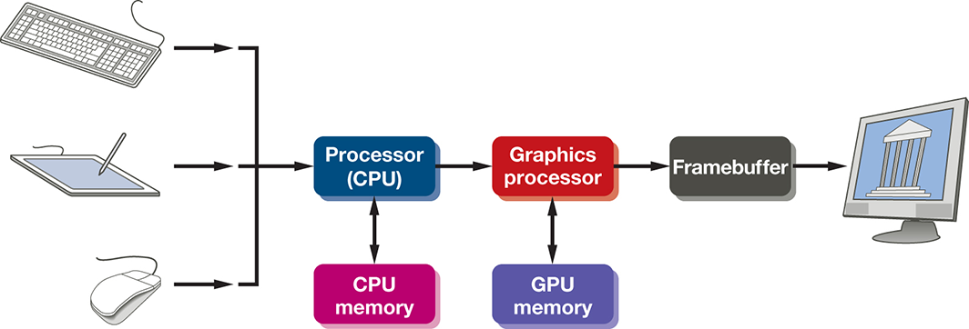
A Basic Graphics System
Input devices
CPU vs. GPU
Computing & rendering system
Output devices

Slide 8
Input Devices
Keyboard
Mouse
Game controller
Tablet & Pen
Other sensors
Data glove
Sound
Gesture
Etc.

Slide 9
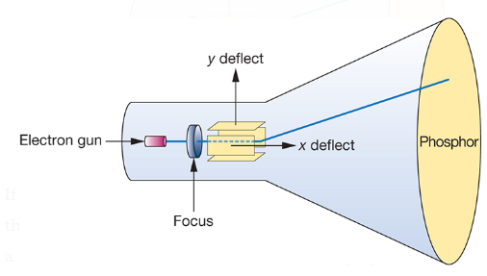
Output Devices
CRT (Cathode Ray Tube)
Electrons strike Phosphor coating and emits light
Direction of beam controlled by deflection plates
Random-scan, calligraphic or vector CRT
Moving beam to new location
Refresh rate: 60 Hz – 85 Hz

Slide 10
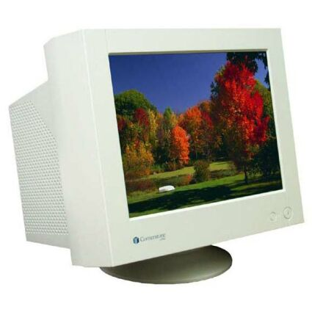
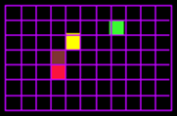
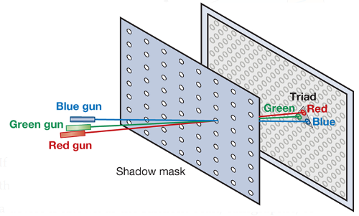
Output Devices (Contd.)
Raster CRTs (n x m phosphor)
Framebuffer Depth
1 bit: 2 levels only, b/w
8 bits: gray scale, 256 gray levels or colors
8 bits per color (RGB) = 24 bits = 16M colors
12 bits per color: HD
3 different colored Phosphors: triads
Shadow mask
Interlaced vs. Non-Interlaced displays
Interlaced: used in commercial TV
Single vs. double buffering

Slide 11
Output Devices (Contd.)
Screen Resolutions of Raster CRTs (n x m phosphor)
TV: 640x480 pixels
HD: 1920x1080
4K LCD: 3840x2160
35mm: 3000x2000
How a TV works in slow motion (interlaced): https://youtu.be/3BJU2drrtCM?t=162

Slide 12
Output Devices (Contd.)
Memory Speed & Space Requirements
Screen resolution = n x m
Refresh rate = r Hz (frames/second)
Interlaced vs. non-interlaced
Color depth = b bits/pixel
Memory space per second = (n * m * b * r) / 8 bytes
If non-interlaced, memory read time = 1 / (n * m * r) secs/pixel
If interlaced, memory read time = 2 / (n * m * r) secs/pixel

Slide 13
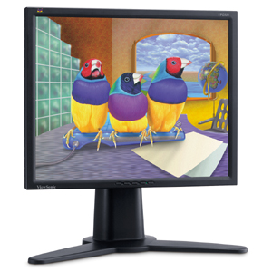
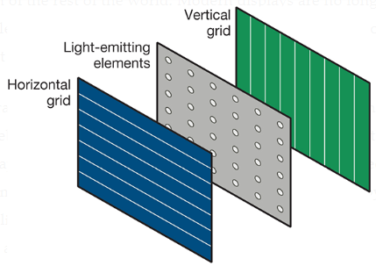
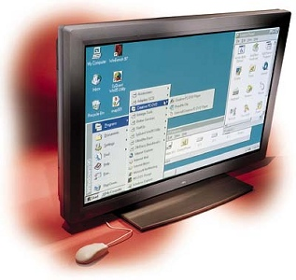
Output Devices (Contd.)
Flat Screen Displays
Raster Based: active matrix with transistors at grid points
LEDs: light emitting diodes
LCDs: polarization of liquid crystals
Plasma: energize gases to glow plasma

Slide 14
Output Devices (Contd.)
Other Output Devices
Printers & Plotters: raster based, no refresh
Stereo Displays: 3D TVs/movies, fast switching of left and right eye polarized images

Slide 15
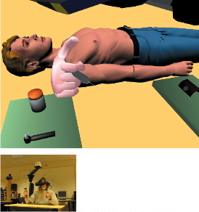
Output Devices (Contd.)
VR (Virtual Reality)
Flat panel technology
Stereoscopic
Track body, finger, and head locations
Foveated Rendering: hi-res where viewer is focusing, lo-res elsewhere
Other input devices: force sensing gloves, sound

Slide 16
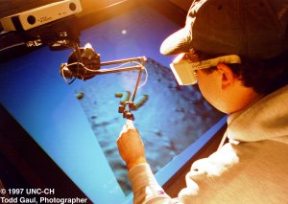

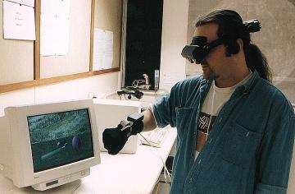
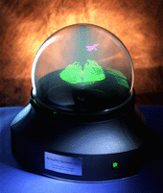
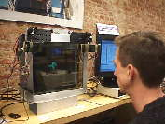
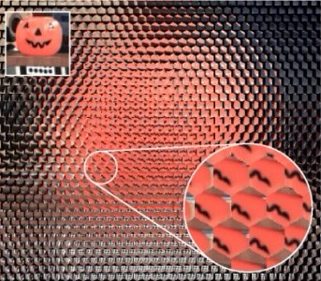
Exotic Display Devices
Head-Mounted
Immersive
Holographic
Autostereoscopic
Volumetric

Slide 17
More Recent Display Technologies
Anamorphic LED Displays
Roaring Lion, Nike Ad
Holographic Real Time Displays
Dr Hologram
Spherical LED Displays
MSG Sphere

Slide 18
Aliasing in Raster Displays
Aliasing
Lines
Polygons
Reasons for Aliasing
Location of pixels are fixed
Size of pixels are fixed
Shape of pixels are fixed

Slide 19
SIGGRAPH 2018 Research Trailers
May 2018:
https://www.youtube.com/watch?v=t952yS8tcg8
November 2018:
https://www.youtube.com/watch?v=wdKpXvF_3AU

Slide 20
SIGGRAPH 2017 Research Trailers
May 2017:
https://www.youtube.com/watch?v=3OGKh_9Rj_8
November 2017:
https://www.youtube.com/watch?v=5YvIHREdVX4

Slide 21
Industry Hacks
New Powerful Visual Effect tool for 3ds Max: tyFlow
https://www.youtube.com/watch?v=ct3vWWl86f8
Tools packaged with production software suites
Video does not claim to use any math that converges to real-life physics formulas
Approximation is not convergence!

Slide 22
Linear Algebra Review

Slide 23
Linear Algebra: The Algebra of Vectors and Matrices (and Scalars)
Vector spaces
Matrix algebra
Coordinate systems
Affine transformations

Slide 24
Vectors
N-tuple of scalar elements
Vector:
Bold lower-case
Scalar:
Italic lower-case
Notes:
\documentclass{slides}\pagestyle{empty}
\begin{document}
\begin{eqnarray*}
& & {\bf v} = (x_1,x_2,\dots,x_n), \;\; x_i \in \Re \\
\end{eqnarray*}
\end{document}

Slide 25
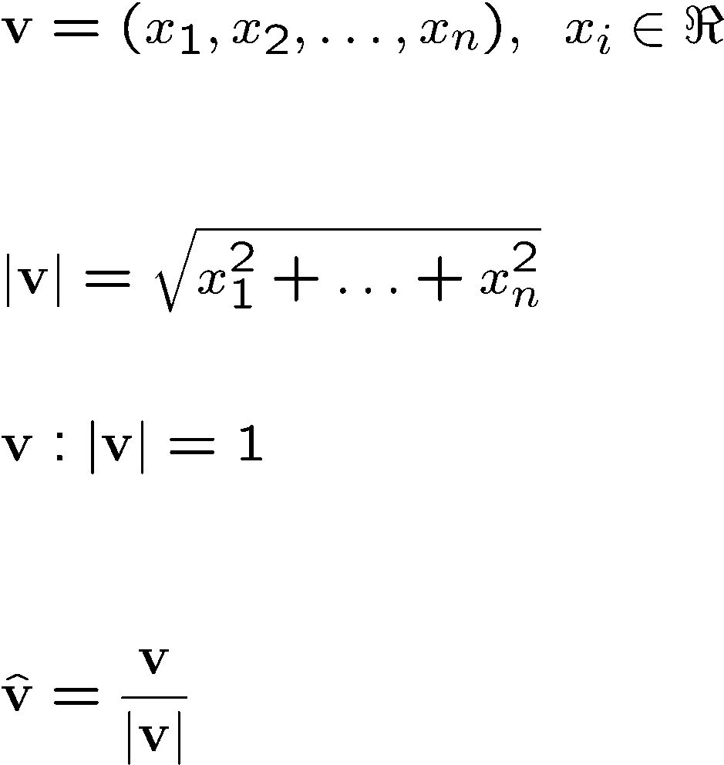
Vectors
N-tuple:
Magnitude:
Unit vectors
Normalizing a vector
Notes:
\documentclass{slides}\pagestyle{empty}
\begin{document}
\begin{eqnarray*}
& & {\bf v} = (x_1,x_2,\dots,x_n), \;\; x_i \in \Re \\
~\\
~\\
& & |{\bf v}| = \sqrt{x_1^2+\dots+ x_n^2}
~\\
~\\
& & {\bf v}: |{\bf v}| =1 \\
~\\
~\\
& & \hat{\bf v} = \frac{\bf v} {|{\bf v}|}
\end{eqnarray*}
\end{document}

Slide 26
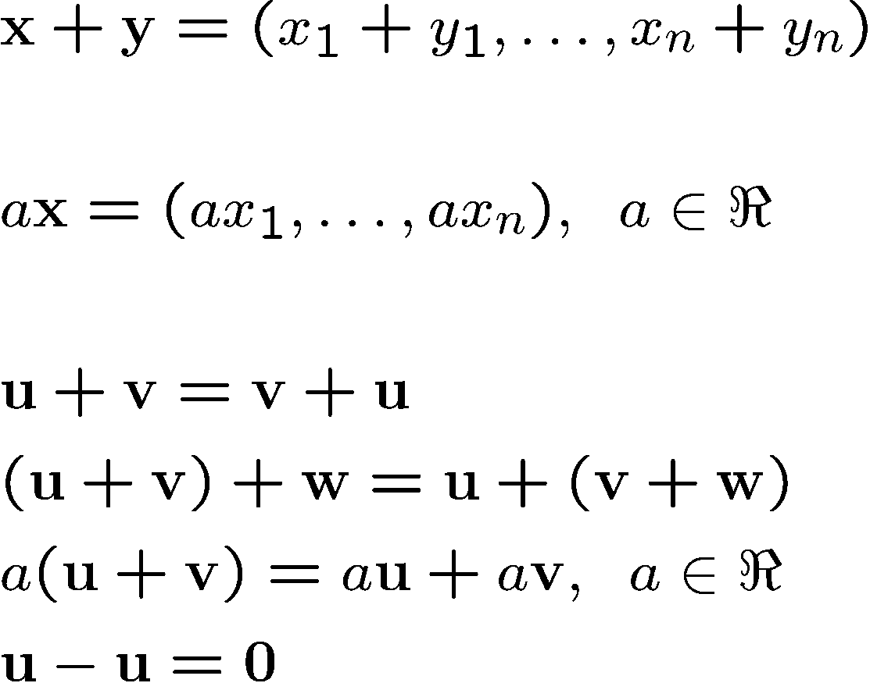
Operations with Vectors
Addition
Multiplication with scalar (scaling)
Properties
Commutative:
Associative:
Distributive:
Notes:
\documentclass{slides}\pagestyle{empty}
\begin{document}
\begin{eqnarray*}
& &{\bf x}+{\bf y} = (x_1+y_1,\dots, x_n+y_n) \\
~\\
& & a{\bf x} = (ax_1,\dots, ax_n), \;\; a \in \Re \\
~\\
& & {\bf u} + {\bf v} = {\bf v}+{\bf u} \\
& & ({\bf u} + {\bf v}) + {\bf w} = {\bf u} + ({\bf v} + {\bf w}) \\
& & a({\bf u} + {\bf v}) = a{\bf u} + a{\bf v}, \;\; a \in \Re \\
& & {\bf u} - {\bf u} = {\bf 0}
\end{eqnarray*}
\end{document}

Slide 27
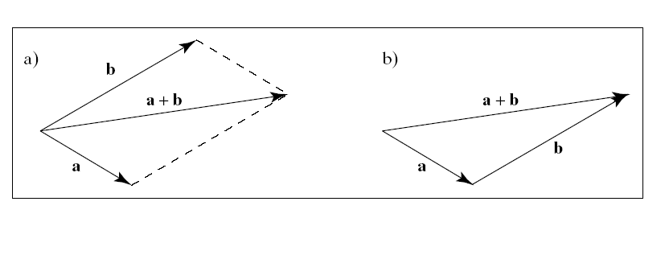
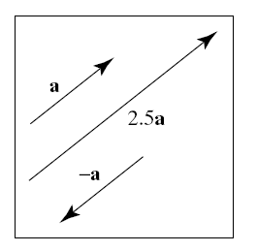
Visualization of 2D and 3D Vectors
Addition
Scaling

Slide 28
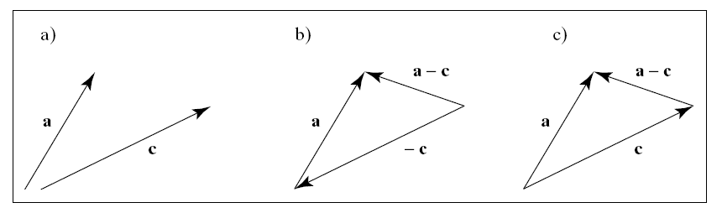
Subtraction
Adding the negatively scaled vector

Slide 29
Linear Combination of Vectors
Definition
A linear combination of the m vectors v₁,…,v_{m} is a vector of the form:
w = a₁v₁ +…+ a_{m}v_{m}, a₁,…,a_{m} in R

Slide 30
Special Cases
Linear combination
w = a₁v₁+…a_{m}v_{m}, a₁,…,a_{m} in R
Affine combination:
A linear combination for which a₁+…+a_{m}=1
Convex combination
An affine combination for which a_{i}≥0 for i=1,…,m

Slide 31
Linear Independence
For vectors v₁,…,v_{m}
If a₁v₁+…+a_{m}v_{m}=0 iff a₁=a₂=…=a_{m}=0
then the vectors are linearly independent

